Slide 1
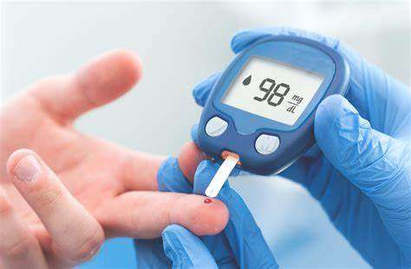
Diabetes Prediction System

Slide 2

C.V RAMAN GLOBAL UNIVERSITY BHUBANESWAR,ODISHA,INDIA
TOPIC:-”Diabete Prediction System”
Under the super vision of
“Miss. Anisha Mukherjee”
Submitted by
RUDRA P. SAHU SWAGAT SWAIN
SMRUTI R. SWAIN SWAPNIL PANIGRAHI
SUBHAMJIT SWAIN SWETA S. SWAIN
SUGYANI R. PANDA TANISHQ CHITRANSH
VIJIT KUMAR JAYANT KUMAR
AMAN K NAYAK AKASH ANDIA

Slide 3
INDEX
1
2
3
4
5
INTRODUCTION
APPLICATION
AND
REQUIREMENTS
EXPLANTION OF CODE
OUTPUT
CONCLUSION

Slide 4
INTRODUCTION
Diabetes is a chronic disease that affects millions of people
worldwide. It occurs when the body is unable to produce or
properly use insulin, a hormone that regulates blood sugar levels.
Early detection and management of diabetes are crucial to
preventing complications such as heart disease, kidney damage,
and blindness. With the advent of machine learning, it is now
possible to predict the onset of diabetes using a variety of factors.
This case study focuses on the six different factors that are
commonly used in diabetes prediction: glucose level, blood
pressure, skin thickness, insulin level, body mass index (BMI),
and age.
Each of these factors has a specific range of values that
are considered normal. By analyzing these factors, a machine
learning algorithm can determine whether an individual is at risk
for diabetes.

Slide 5
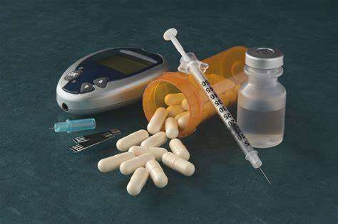
Application
We have developed a Python program that allows users to enter the values of the six factors and determine whether they are at risk for diabetes. The program first prompts the user to enter the glucose level, blood pressure, skin thickness, insulin level, BMI, and age. It then checks if each value is within the normal range specified in the table.
If all values are within the normal range, the program determines whether the individual is at risk for diabetes based on the table's values. If the values are not within the normal range, the program outputs an error message prompting the user to enter a valid value.

Slide 6
REQUIREMENTS
Operating System: Python is compatible with various operating systems, including Windows, macOS, and Linux. Ensure that your system supports one of these operating systems.
Python Interpreter: You need to install a Python interpreter on your system. The interpreter is responsible for executing Python code. You can download the Python interpreter from the official Python website (https://www.python.org) and choose th appropriate version for your operating system.
Installation: Once you've downloaded the Python interpreter,run the installer and follow the on screen instructions to installPython on your system. Make sure to add Python to your system's PATH environment variable during the installation process. This allows you to run Python from any directory in the command prompt or terminal.
Integrated Development Environment (IDE): While not strictly necessary, an IDE can greatly enhance your development experience. There are several popular Python IDEs available,such as PyCharm, Visual Studio Code (with Python extension),and Atom (with Python packages). Choose an IDE that suits your preferences and install it on your system.

Slide 7
REQUIREMENTS
Code Editor: If you prefer a lightweight option over a full_x0002_fledged IDE, you can use a code editor like Sublime Text, Notepad++, or Vim. These editors provide syntax highlighting and basic code editing features for Python.
Packages and Libraries: Python has a vast ecosystem of packages and libraries that extend its functionality. Depending on your project's requirements, you may need to install additional packages using Python's package manager, pip. You can install packages by running the following command in the command prompt or terminal: pip install package_name.
Text Editor or Command Prompt: To write and execute Python code, you can use a text editor to create Python files with a .py extension. Alternatively, you can use the command prompt or terminal to run Python interactively or execute Python scripts.

Slide 8
Explanation of Code
The Python program starts by defining the normal range of values for each factor as a dictionary. The keys of the dictionary are the factor names, and the values are tuples that define the minimum and maximum values for the factor. For example, the glucose level is defined as (80, 180), which means the normal range of glucose levels is between 80 and 180.
The program then prompts the user to enter the values for each factor using the input() function. The input values are checked against the normal range of values using a series of if statements. If the input value is within the normal range, the program proceeds to the next factor. If the input value is not within the normal range, the program outputs an error message and prompts the user to enter a valid value.
Once all values are entered and validated, the program checks the values against the table to determine whether the individual is at risk for diabetes. If the individual is at risk, the program outputs "Yes" for diabetes. If the individual is not at risk, the program outputs "No" for diabetes.

Slide 9
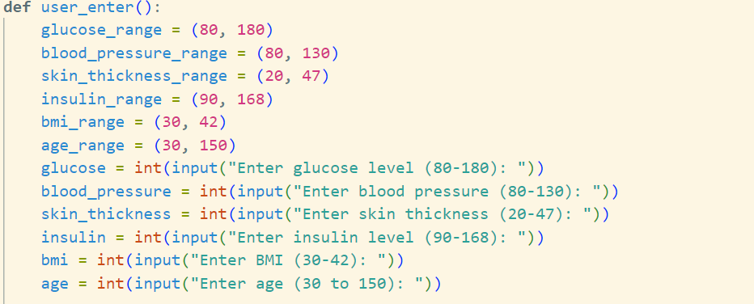
Source code

Slide 10
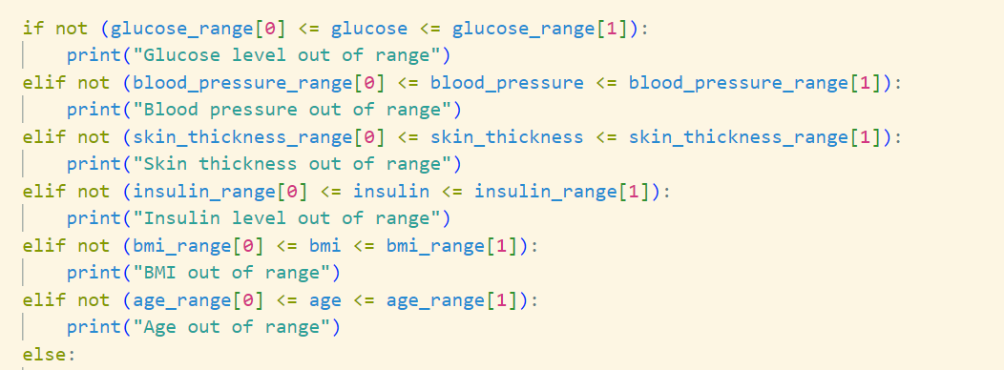
Source code

Slide 11
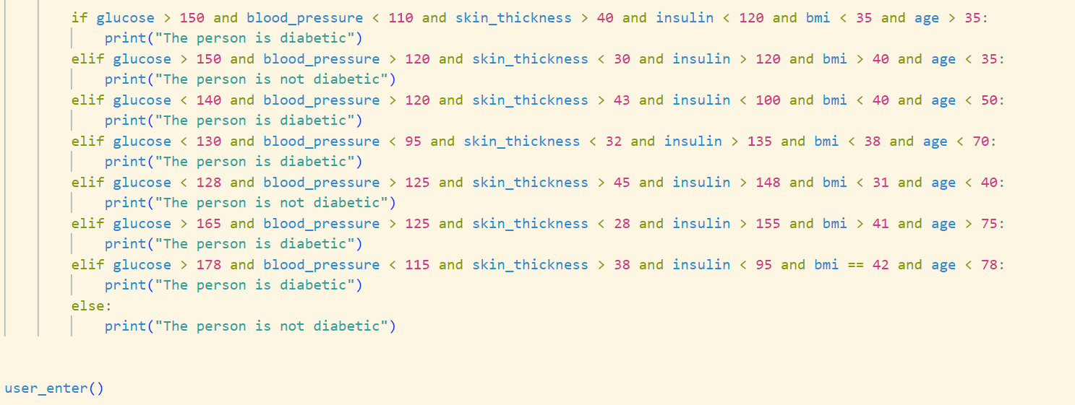
Source code

Slide 12
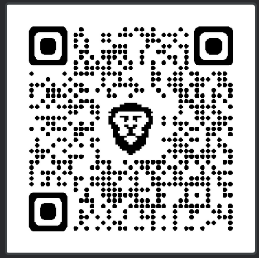
Download The Code By Scanning The QR

Slide 13
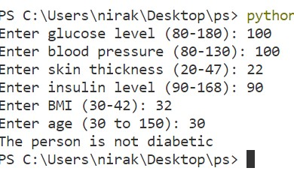
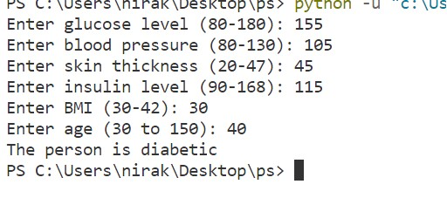
OUTPUT

Slide 14
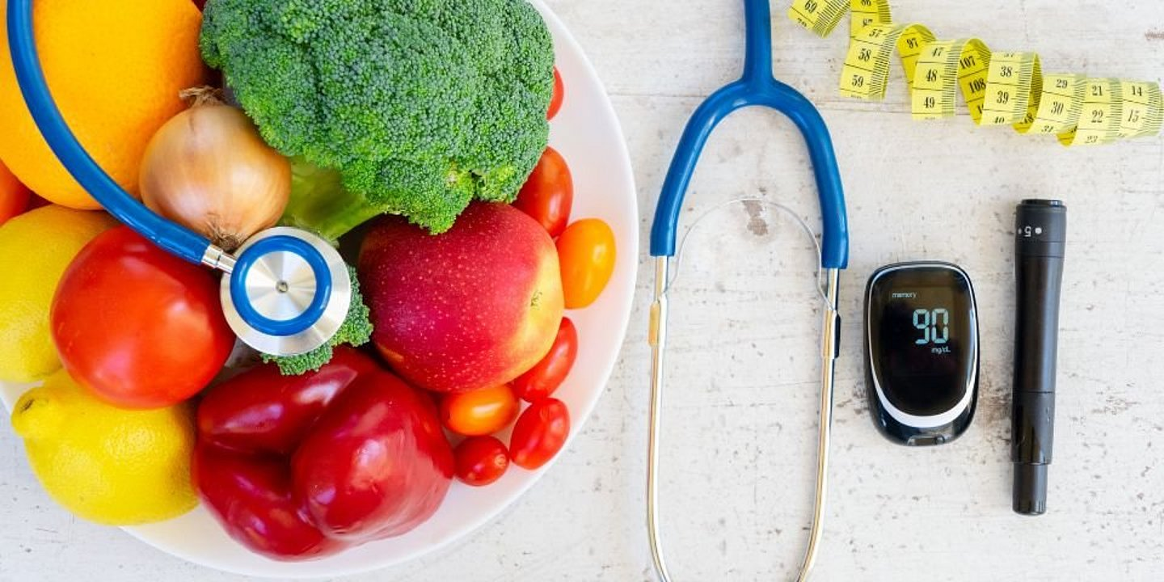
CONCLUSION
Inconclusion,thepredictionofdiabetesusingmachinelearning isanimportantapplicationofdataanalysis.Byanalyzingthesix factorsofglucoselevel,bloodpressure,skinthickness,insulin level,BMI,andage,itispossibletodetermineanindividual's riskfordiabetes.WehavedevelopedaPythonprogramthat allowsuserstoenterthevaluesofthesefactorsanddetermine whethertheyareatriskfordiabetes.Thisprogramcanbeused bymedicalprofessionalsandindividualsaliketohelpmanage theriskofdiabetesandpreventitscomplications.
THANK YOU

